Slide 1
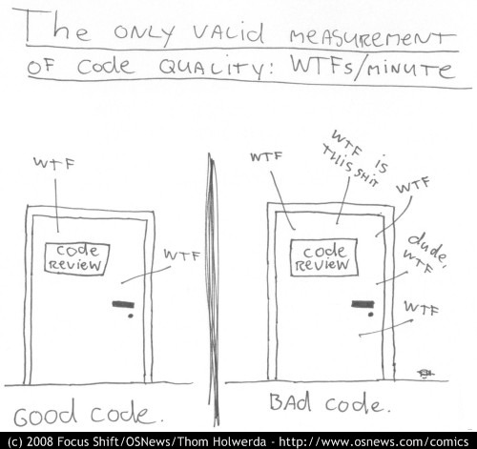
Refactoring towards testable code and happier developers ☺
@dave_mateer

Slide 2

http://persephonemagazine.com/2013/01/gif-it-to-me-baby-wtf/

Slide 3


Slide 4


Slide 5
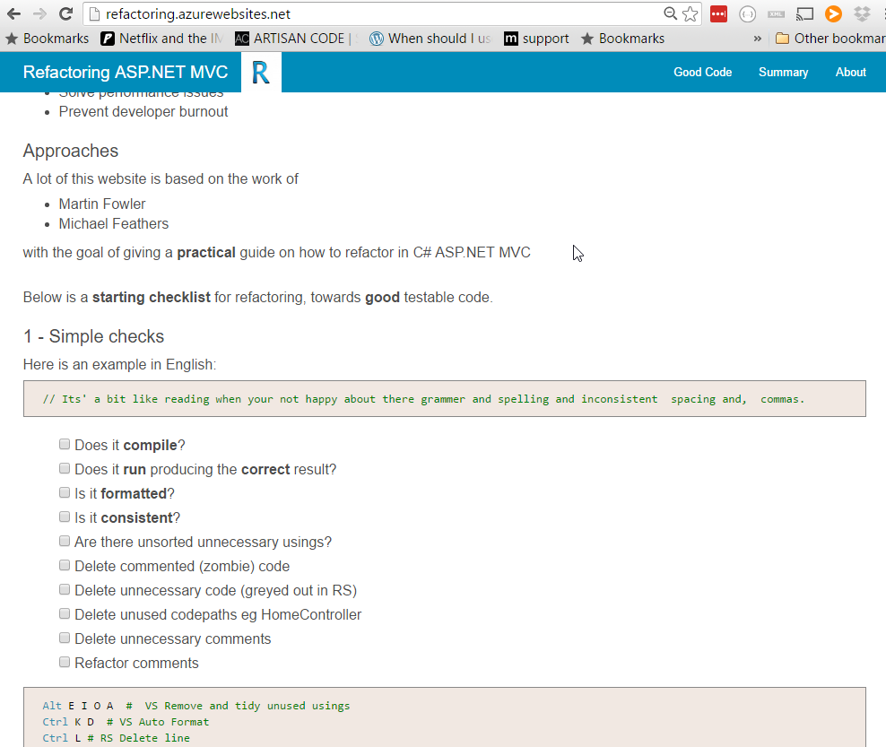
My practical guide (9 months) http:// refactoring .azurewebsites.net tonight.. The good bits

Slide 6








Quorum Network Resources
The kind of clients we work with:

Slide 7
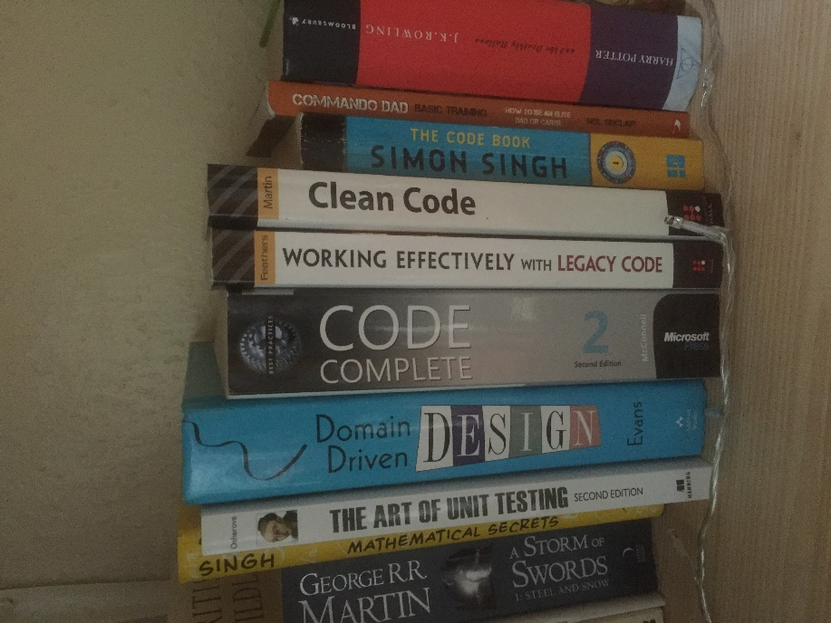


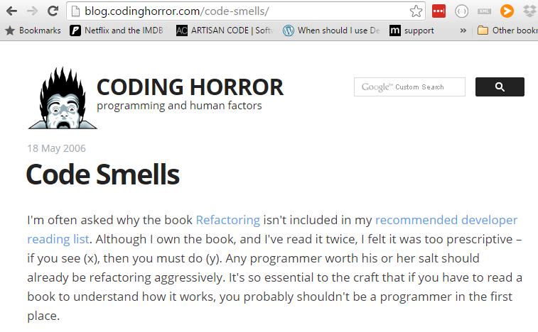
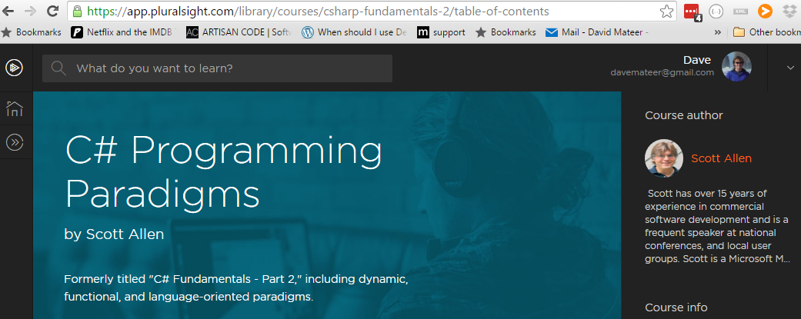
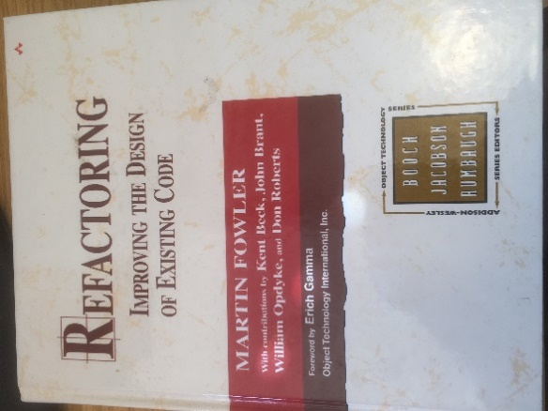
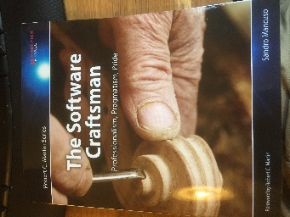
Stand on the Shoulders of Giants

Slide 8

1. Names
Solutions, Projects, Namespaces,
Classes / Files, Methods,
Parameters, Properties, Variables
Adding meaning to code

Slide 9
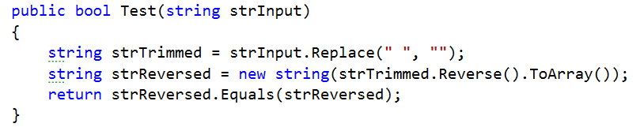
Palindrome tester: words which are the same forwards as reversed eg: noon
Also ignoring any whitespace eg no on
**Example based on K Scott Allen, Pluralsight, C# Programming 2011

Slide 10
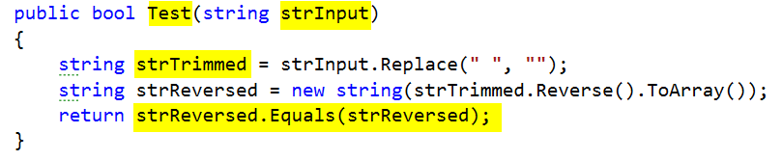
PascalCase convention for method names (C#) - good
Hungarian Notation eg strInput – bad
strTrimmed – trimmed generally means whitespace trim from beginning and end not middle – bad
Bug at the end – should be strTrimmed.Equals(strReversed) - bad

Slide 11
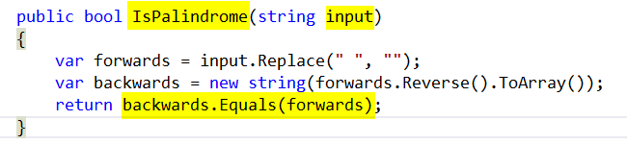
IsPalindrome – descriptive - good
input – simple - good
var keyword - good
Symmetry of final line – conveys exactly what IsPalindrome does - excellent

Slide 12
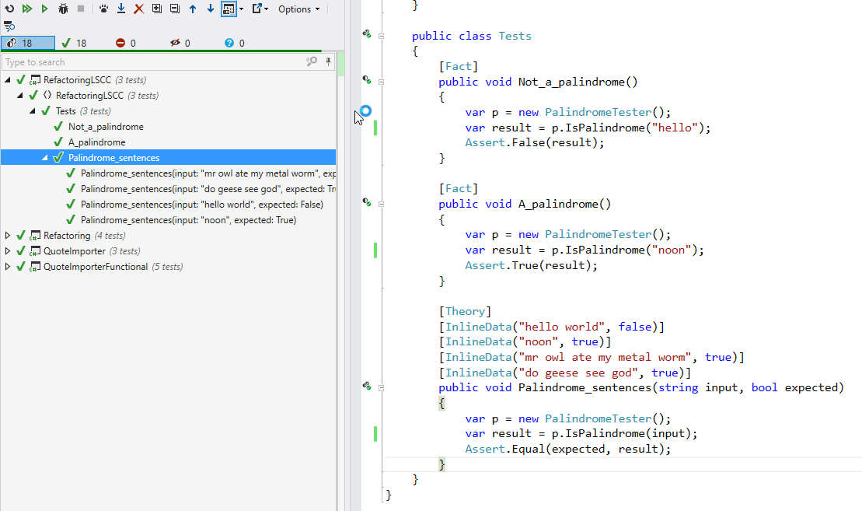

Slide 13

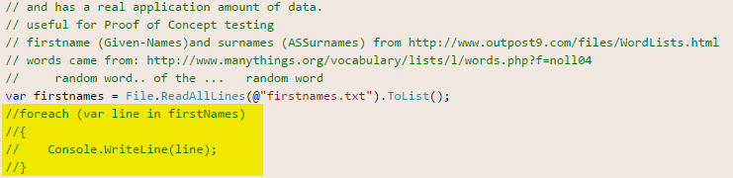
2.Killing Zombies
Kill Zombie (nearly dead) code
https://www.flickr.com/photos/dhollister/2596483147

Slide 14
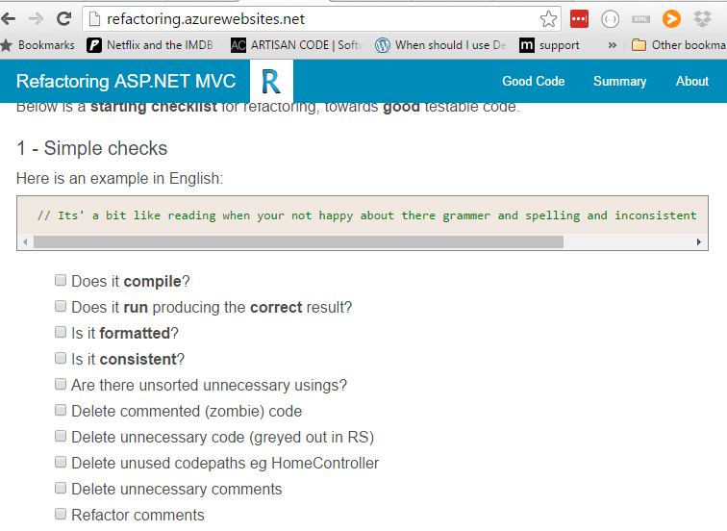

Slide 15

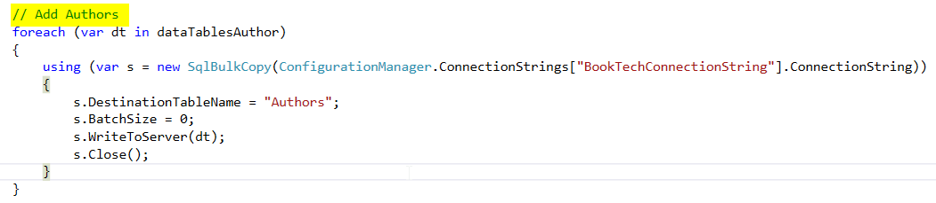
3.Minimise Comments
Candidate to refactor into a Method called AddAuthors?

Slide 16
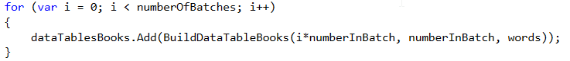
4.Favour Short local scope names

Slide 17

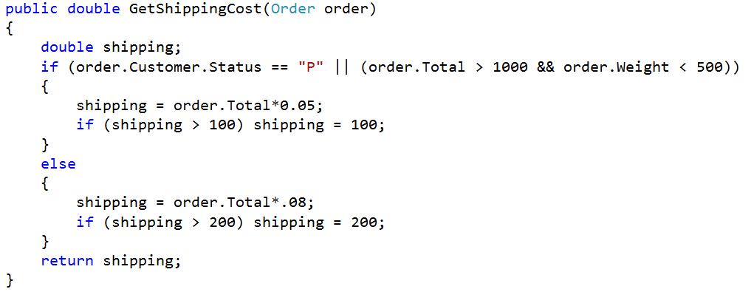
5. Encapsulate Complexity
Inspired by refactoring course on Lynda.com
Bmalarky https://flic.kr/p/9XWL8g

Slide 18
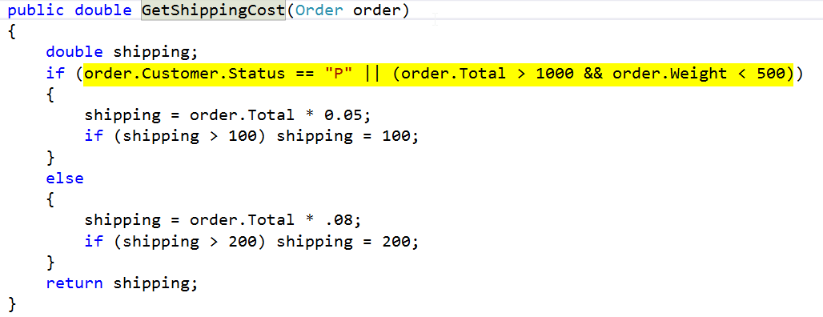
Ctrl R M – Extract Method

Slide 19
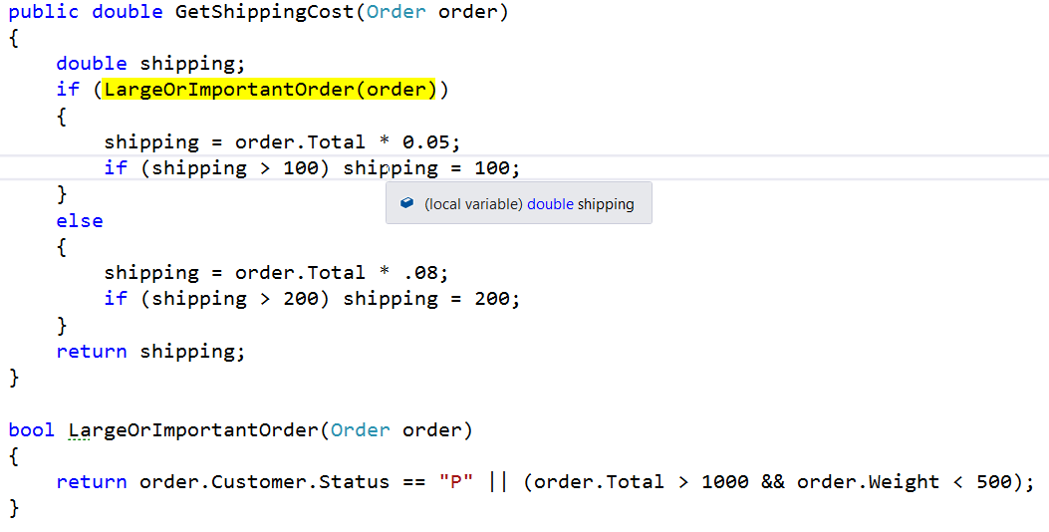

Slide 20
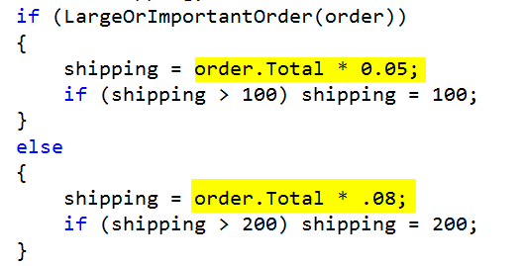
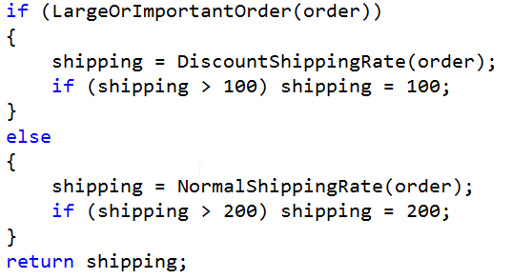

Slide 21
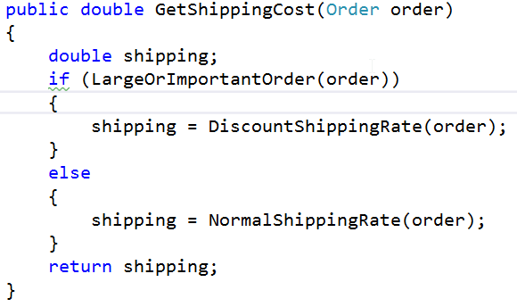
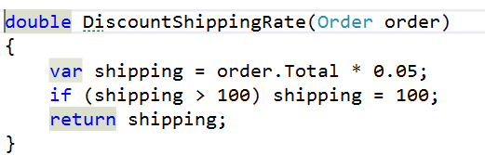
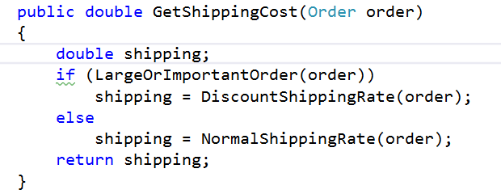

Slide 23
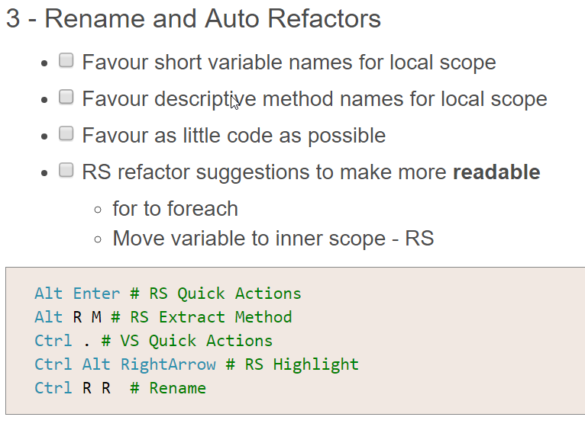
6.WebsiteTips
**move to website from here and talk through..

Slide 24
7.Automation / Tools
Win10 – new shell can copy and paste
code . – for a fast easy editor **DEMO**
.\d trick **DEMO**
Resharper 10 (Personal license okay to use inside work if you buy yourself)
Github Desktop (installs PoshGit – best command line client) **DEMO**
Bitbucket (free private git repos)
Github (public repos)
Appveyor (free build and test server)
Miniprofiler – to see speed of SQL Queries
Source control database (DB Project in VS)
VS2012.5 (inside current corporation)
SSDT to talk to SQL2014
Web tools so can use MVC5
Visio – for mock ups!

Slide 25

8.Refactoring towards Perf / Big Data / Simplicity
Visio diagram of nice DAL tool with inheritance
YAGNI – I don’t need all that mocking etc..
What I need is simplicity
So my ‘DAL’.. Can be called directly from a controller
had a simple util method to feed in a connection
Integration testing is done from an app.config
Refactoring – let SQL Server do heavy lifting
eg Filter / Sort
Return the lightest weight possible
Mulitple returns in SQL Server
Years of junior developers coming into project who need to get up to speed asap
Simple is paramount
Sunny_mjx https://flic.kr/p/qGtWFw

Slide 26
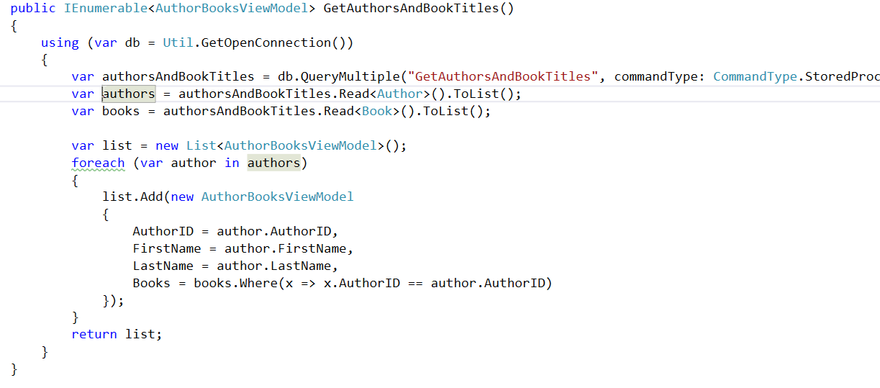
Queries (CQS)
A Command DOES something (and returns void), a Query RETURNS something (no side effects)

Slide 27
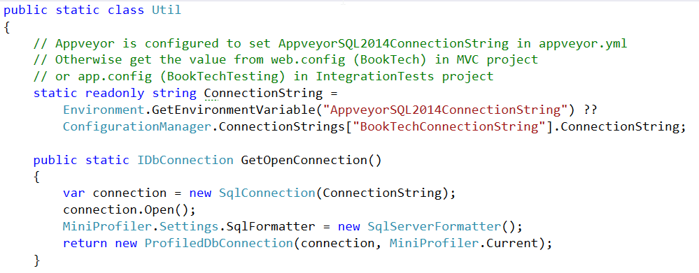
Connection

Slide 28
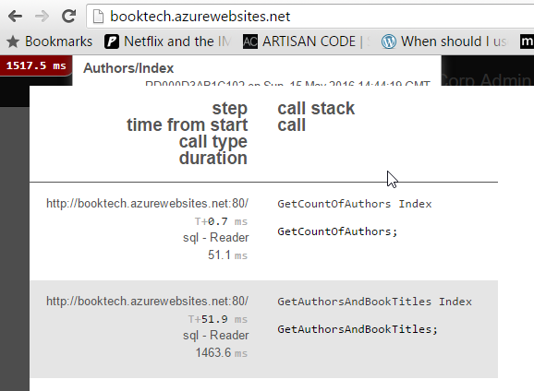
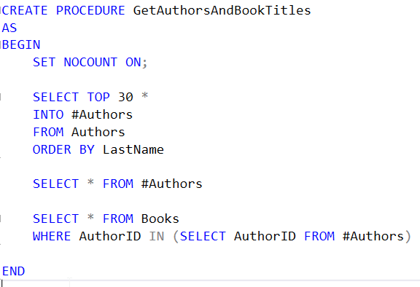
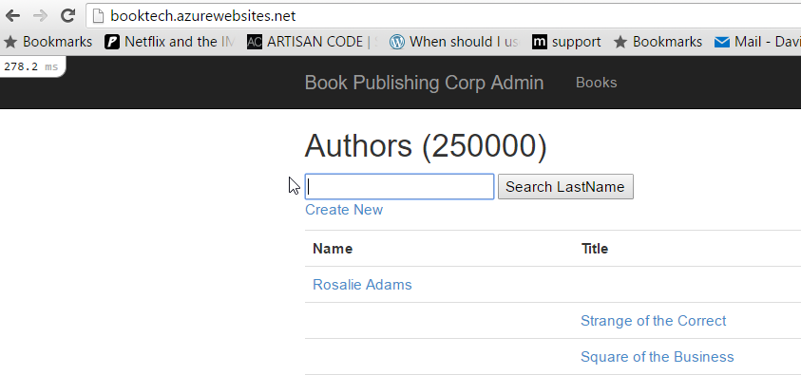
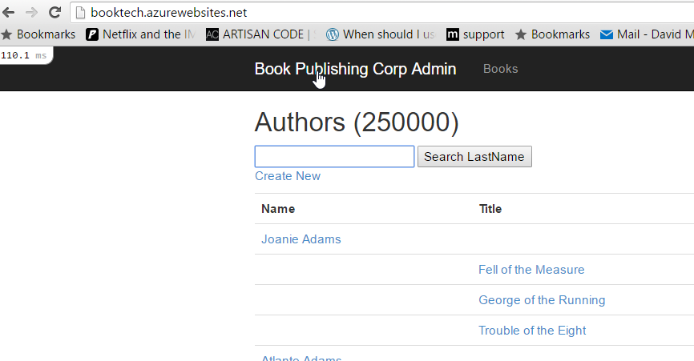
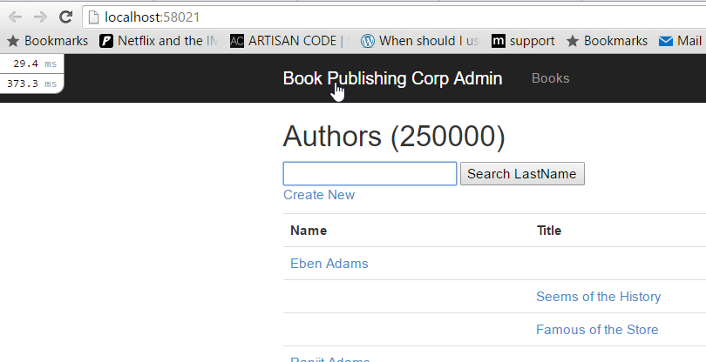
Let the DB do the work
250000 Authors, and 500000 Books.
Query executes in 1500ms (20DTU), 300ms (100DTU), or 110ms (500DTU)

Slide 29
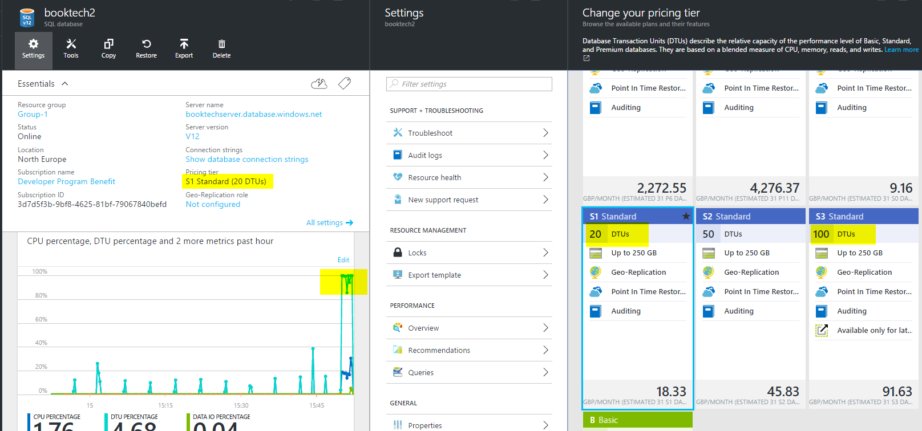

Slide 30
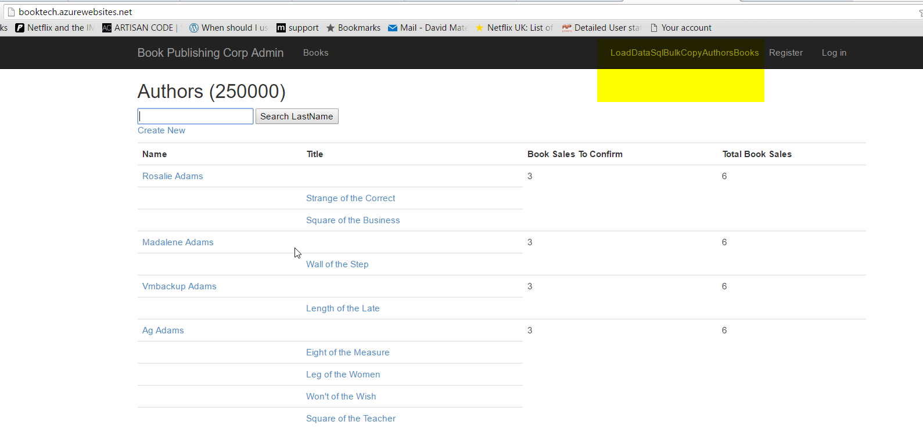

Slide 31
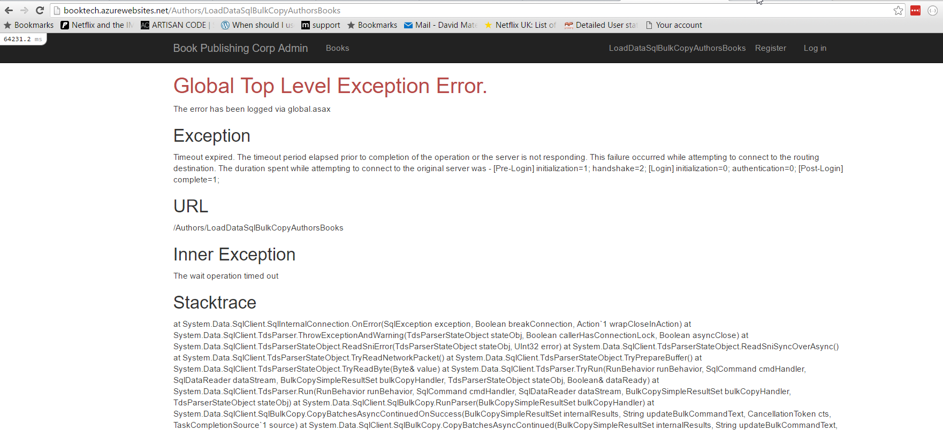
Use Exceptions for Errors
Instead of status codes or Booleans eg here is a SQL Command failing.. Want it to throw an exception

Slide 32
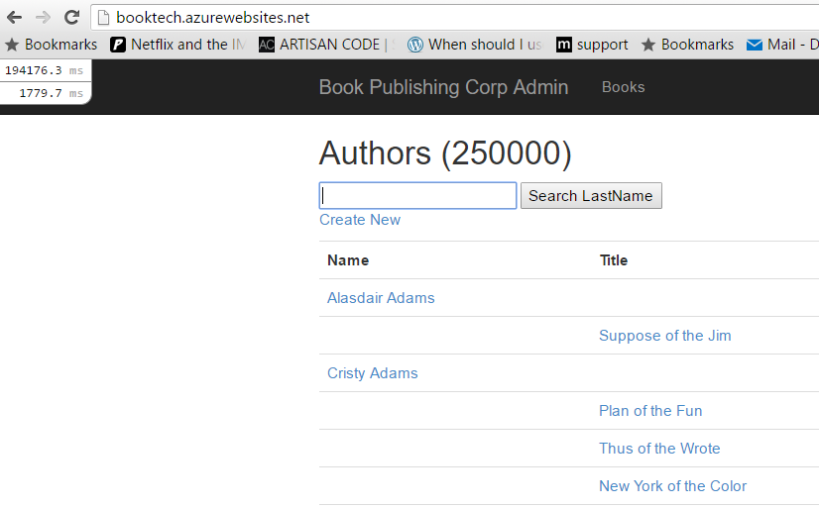
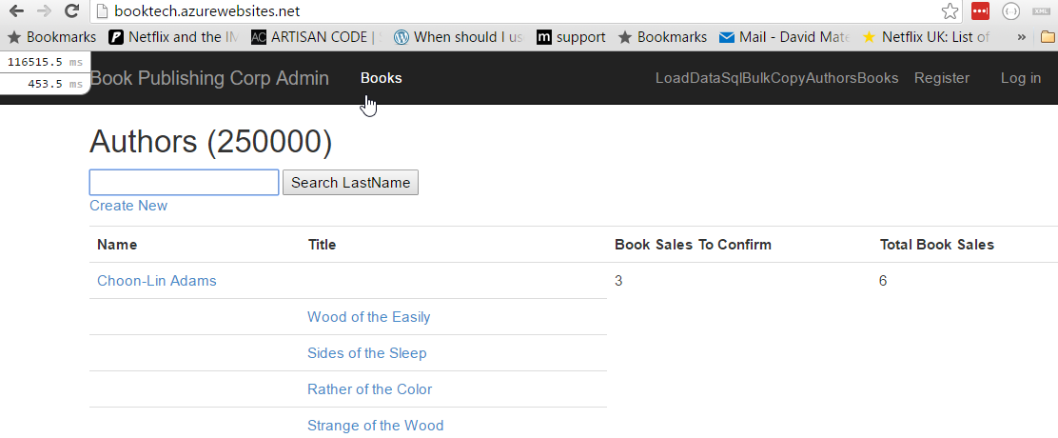
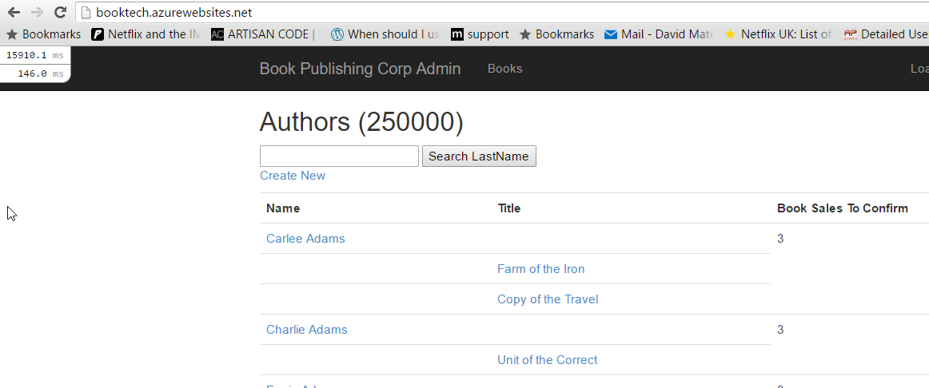
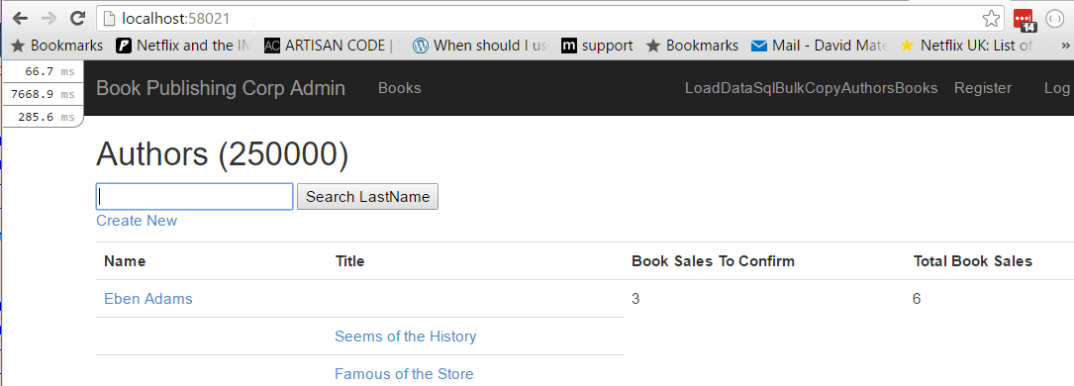

Slide 33
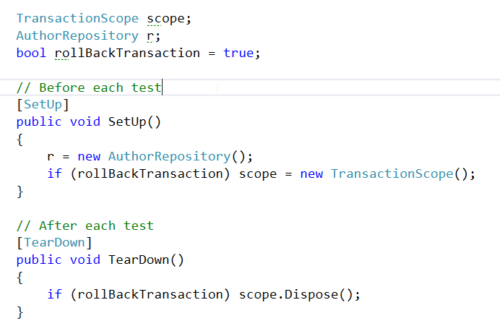
Test Repository against a DB
Have a ‘Minimum’ dataset of a few Authors and Books

Slide 34
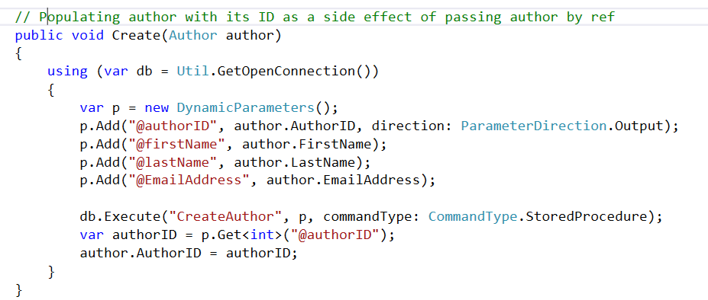
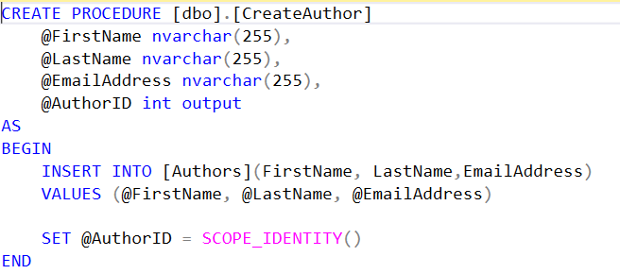
Command

Slide 35
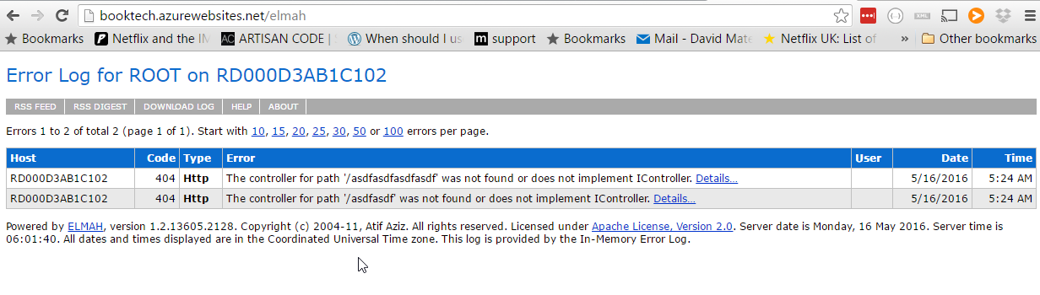
Elmah

Slide 36
Developer happiness and testability
1.Rename things
2.Kill zombies (nearly dead)
3.Favour short local names
4.Minimise comments
5.Encapsulate complexity
6.Automation / Tooling
7.Let exceptions bubble up
8.Performance measure
9.Rollback transaction integration tests
Thank you for listening
Questions / Thoughts?

